Slide 1

Topic: Concurrency and Race Condition
Lecture: Dr. Zhao Jie
Date: 03/30/2026

Slide 2
Reading Assignment
Chapters 26

Slide 3
Agenda
Difference between process and thread
Race condition
Deterministic and non-deterministic
Critical section

Slide 4
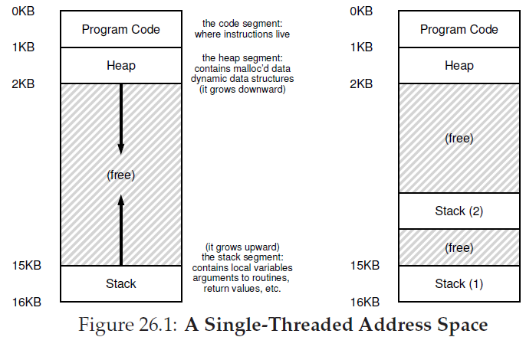
The difference between processes and threads
Multi-threads in a process share the same address space in a process.
Each thread has its own stack. This means a process may have many stack segments if there are multi-threads in the process.

Slide 5
Why use threads?
Parallelism
For example, two large arrays are added. Parallelism converts such a task from a single thread to multi-threads working on multiple CPUs.
Void blocking program progress due to slow I/O
For example, if one thread waits for reading or writing for I/O, the CPU scheduler can switch CPU resources to another thread.
Notes:
Reason 1 is on pg6 of Lecture 7; Reason 2 is on pg7&9 of Lecture 2;

Slide 6
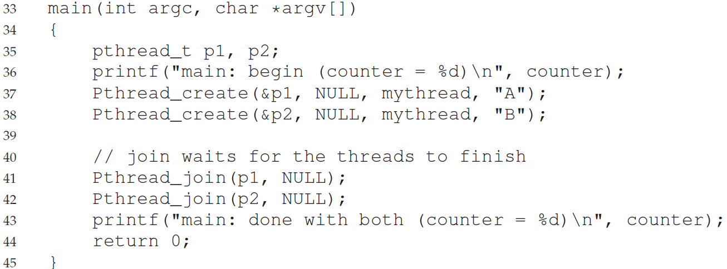
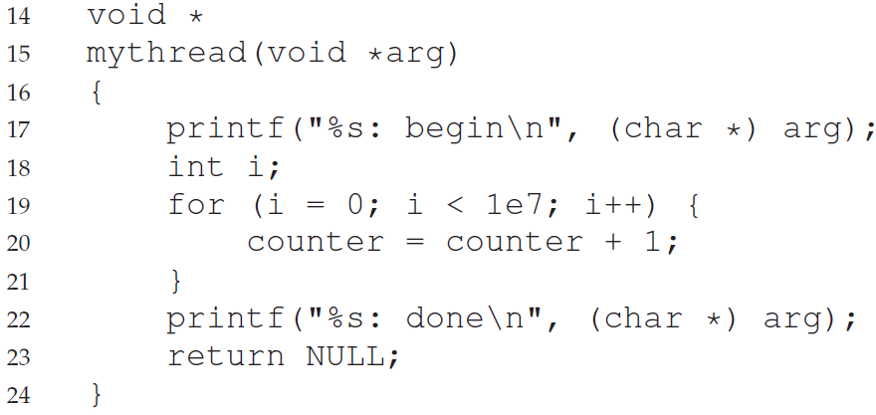
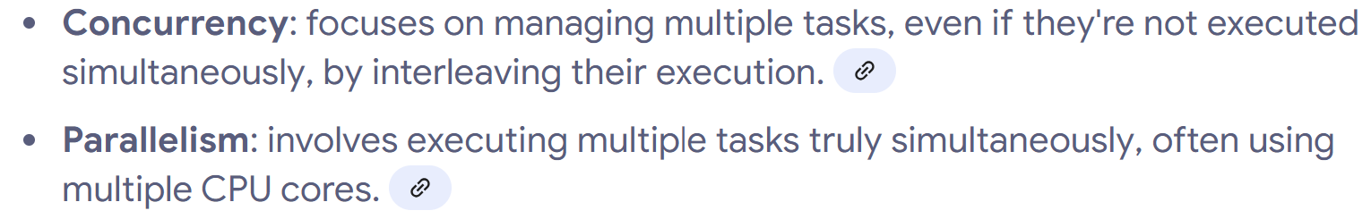
An example of concurrency

Slide 7

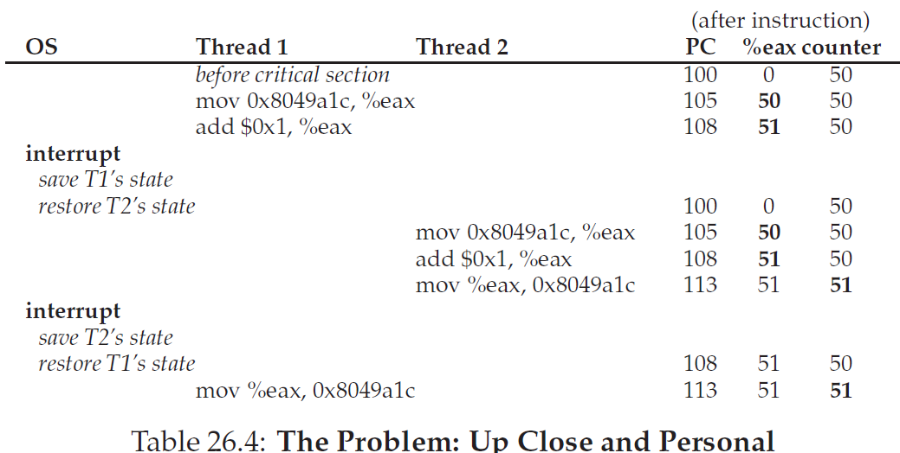
Tracking table for running threads
Assembly code of
Q: What is the issue in this case?
Notes:
Answer: The counter as the shared data is not the result of running T1, but T2. This means that, if T1 and T2 have different arithmetical operations, T1 won’t get correct results in this trace table.

Slide 8
Race condition
Race condition
A race condition arises if multiple execution threads enter the critical section at roughly the same time; both attempt to update the shared data structure, leading to a surprising (and perhaps undesirable) outcome.
Deterministic and indeterministic
An indeterminate program consists of one or more race conditions; the output of the program varies from run to run, depending on which threads ran when. The outcome is thus not deterministic, something we usually expect from computer systems.

Slide 9

The solution to race condition
Critical section (Atomic Unit)
A critical section is a piece of code that accesses a shared resource, usually a variable or data structure.
Mutual exclusion
To avoid these problems, threads should use some kind of mutual exclusion primitives; doing so guarantees that only a single thread ever enters a critical section, thus avoiding races, and resulting in deterministic program outputs.

Slide 10
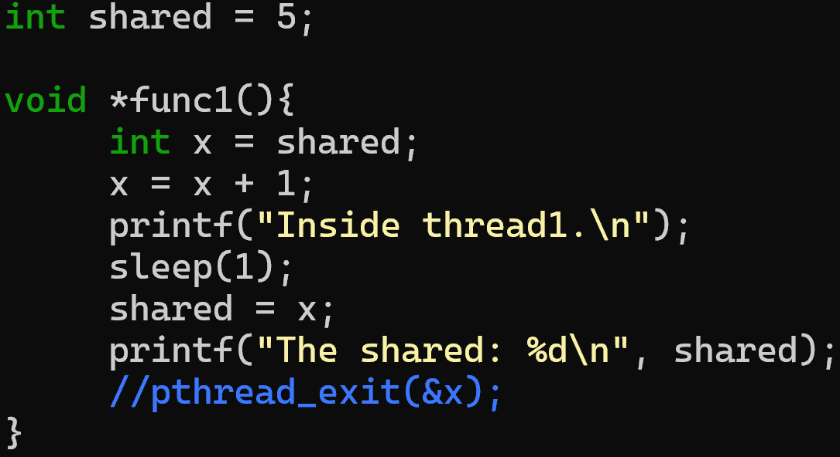
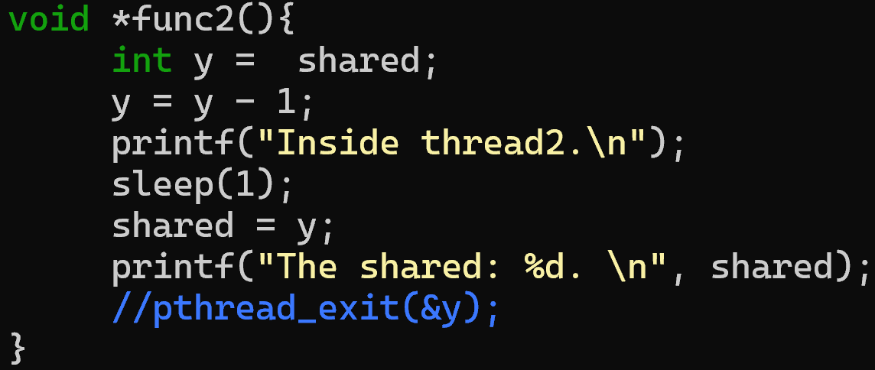
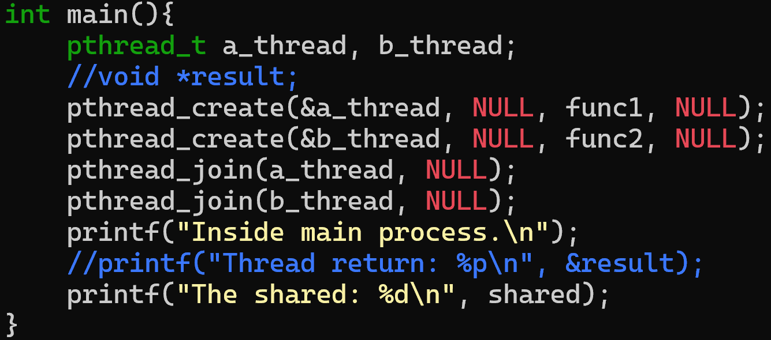
Another example of race conditon

